Slide 1


GStar Bootcamp 2025
Dhruv Agarwal – Personalized AI Tutor

Slide 2


Adaptive AI Tutoring System
AI Tutoring System that transforms how students learn through intelligent, real-time optimization of teaching strategies.
Reinforcement Learning Core
Merlyn Minds 12B Integration
Deep Personalization
Continuously optimizes teaching strategies using direct feedback from student quiz performance, creating a self-improving educational experience.
Leverages education-specific language model enhanced with verifiable rewards from quiz results to deliver personalized responses in real-time.
Integrates user demographics, learning preferences, and academic history to create truly individualized learning experiences that adapt to each student's unique needs.
Technical Innovation
Market Impact
Our streamlined three-component architecture combines knowledge graph-enhanced retrieval with dynamic prompt generation and direct reinforcement learning pipeline for maximum efficiency.
Addresses critical limitations of static AI tutors by enabling curriculum-grounded content delivery that evolves with each learner's progress and performance patterns.

Slide 3


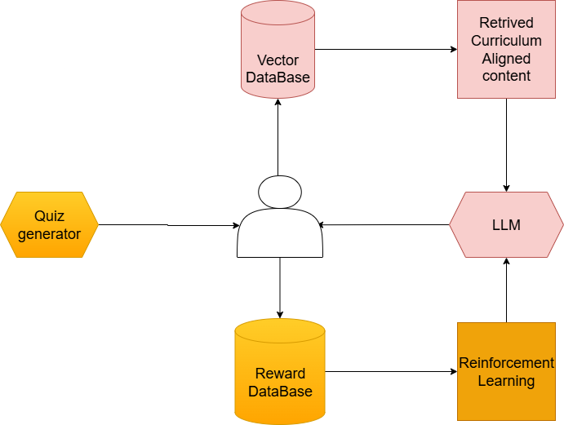

Architecture & Implementation
Preventing Reward Hacking
Reward Model Training
Ensures system integrity by separating quiz generation from response generation, preventing manipulation of the learning feedback loop.
Trains sophisticated reward models using context-reward pairs from student interaction history to accurately predict effective teaching strategies.
Effectiveness Measurement
Tracks learning progress through changing quiz scores and comprehensive knowledge retention testing at 1-week and 1-month intervals.
Github: https://github.com/sunnnybala/Gstar-individual-project

Slide 4
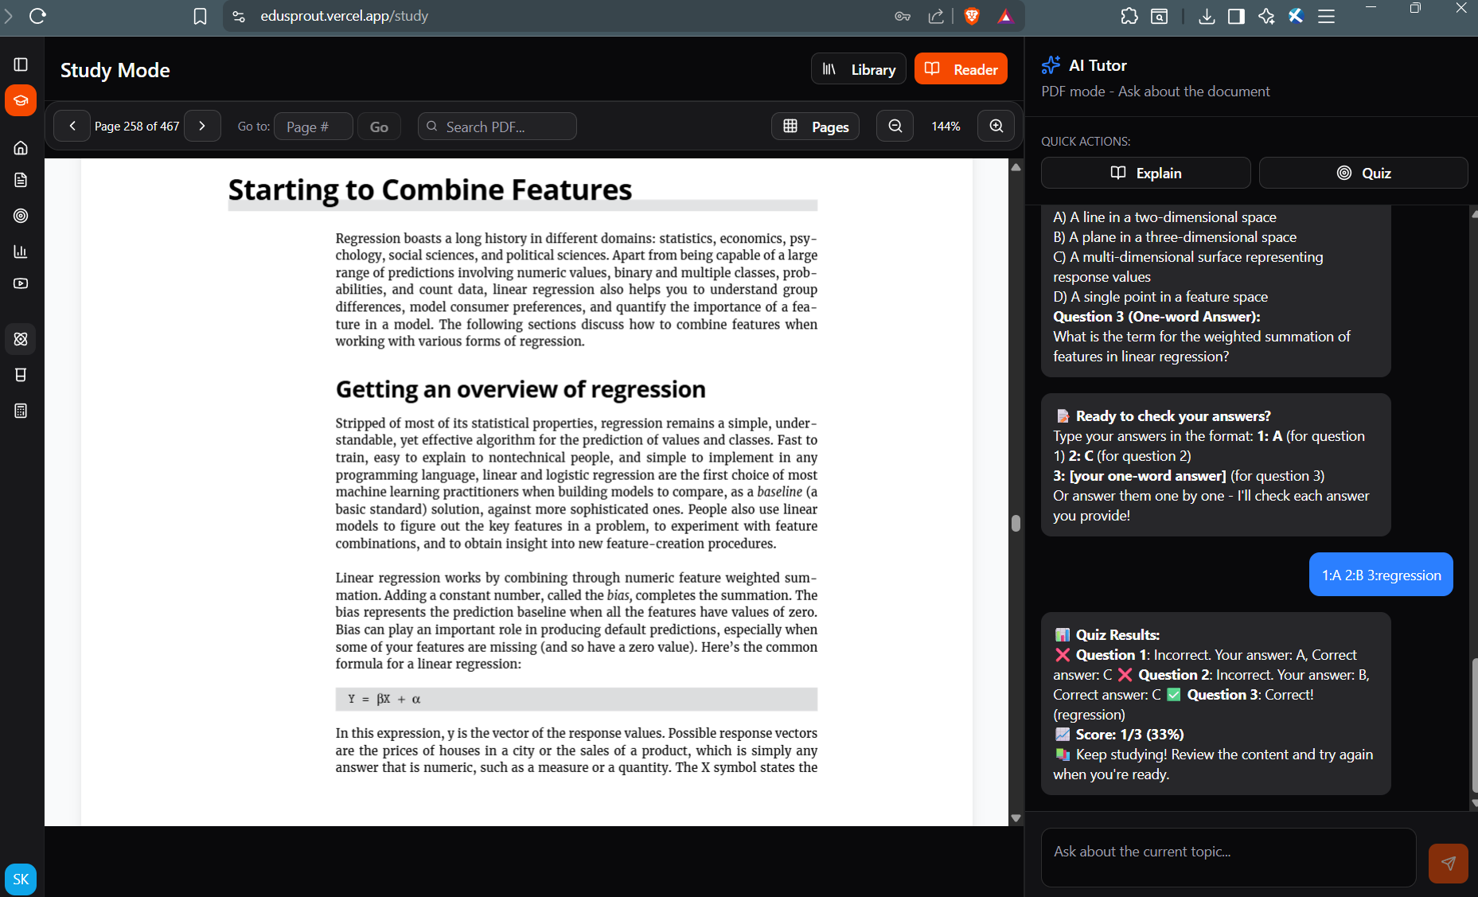
Future Work
Integrate the model with the presented UI to enable real-time tutoring, quizzes, and event logging for analytics.
Verifiable Learning
Run the RL loop on real user interactions and evaluate with actual users for learning gains, retention, and engagement.

